Slide 1
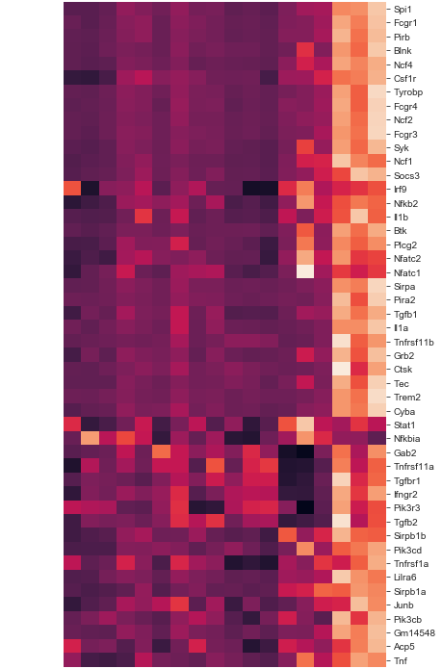
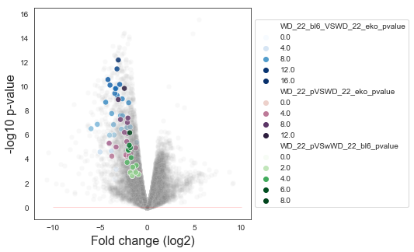
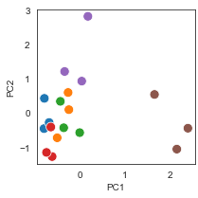
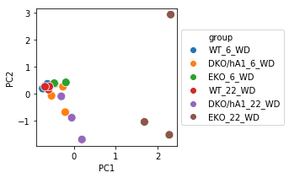
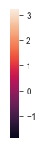
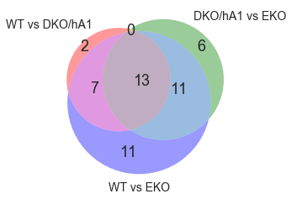
A
Figure X
B
C
13
group
Group 1 T1
Group 2 T1
Group 3 T1
Group 1 VS 2
Group 1 T2
Group 2 T2
Group 3 T2
Group 1 VS 3
7
Group 2 VS 3
11
D
Differentially expressed genes between group 1 vs 2, 1 vs 3 and 2 vs 3 were subjected to a functional enrichment analysis. All genes cumulatively annotated in Osteoclast differentiation KEGG pathway (mmu04380) are herein presented in detail. The Z-scored expression value for these genes is shown in A for all samples. The expression levels for these genes in each sample has been reduced to two principal components (PC), charted in B.
2
Group 1 VS 2
Group 1 VS 3
6
11
Group 2 VS 3
Group 1
A volcano plot of the log₂ fold change in the expression, always with respect to the least treated group of the comparison, is shown for each of these genes (DE genes in each respective comparison) in C. In gray, all other genes. The Venn diagram in D tracks which genes are shared between comparisons, and their expression can be found in A.
Timepoint 1
Timepoint 2
Group 2
Group 3
Notes:
Fatta da:
/Users/manz/Dropbox/manz @lab3/Esperimenti/Illumina 73 (Trascrittomica aorte BL6, EKO, 73+, 73-) (2011 - 2013)/Rielaborazione dati finale Manz+Bus/STRING
Analisi pathway B osteoclast.ipynb
Warning: these genes drawn from STRING apparently do not appear in our dataset.
{'Lilrb4', 'Sirpb1c’}
Ad es, nel nostro dataset è Lilr4b e STRING lo vede come Lilrb4. Cercarli a mano è una palla fotonica
** New numbers in the heatmap **
================================
arancione: 2
colore_indefinito: 0
verde: 6
rosa: 7
comuni: 13
azzurro: 10
blu: 10
A: espressione di questi geni (standard scale su righe)
B: PCA
C: volcano plot di dove stanno, scala di blu per bl/6, scala di rosa per DKO. In grigio tutti gli altri. Linea rossa: p=0.05
D: Venn

